Slide 1
The Factory Pattern

Slide 2
One of the goals of object-oriented design is to delegate responsibility among different objects. This kind of partitioning is good since it encourages Encapsulation and Delegation.
Sometimes, an Application (or framework) at runtime, cannot anticipate the class of object that it must create. The Application (or framework) may know that it has to instantiate classes, but it may only know about abstract classes (or interfaces), which it cannot instantiate. Thus the Application class may only know when it has to instantiate a new Object of a class, not what kind of subclass to create.
a class may want it's subclasses to specify the objects to be created.
a class may delegate responsibility to one of several helper subclasses so that knowledge can be localized to specific helper subclasses.

Slide 3
Factory Method is a creational pattern. This pattern helps to model an interface for creating an object which at creation time can let its subclasses decide which class to instantiate. We call this a Factory Pattern since it is responsible for "Manufacturing" an Object. It helps instantiate the appropriate Subclass by creating the right Object from a group of related classes.

Slide 4
The Factory Pattern is all about "Define an interface for creating an object, but let the subclasses decide which class to instantiate. The Factory method lets a class defer instantiation to subclasses" Thus, as defined by Gamma et al, "The Factory Method lets a class defer instantiation to subclasses".
Figure 1 in next slide illustrates the roles of the Factory Pattern.

Slide 5
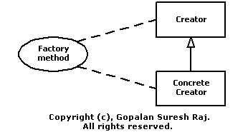
Figure 1: The roles of the Factory Pattern

Slide 6
Implementation
Our Example: To restrict access to authorized personnel and to prevent information glut by loading users with information that would be useless to them, lots of ecommerce applications, provide profile management by storing static and dynamic information about users. Providing individual or multiple users access to resources such as individual files, directory structures, user-defined entities (such as catalogs, purchase orders etc.) etc., can be controlled based on the individual/group's organization/role with and within an organization. Our example here, ensures information control, by providing Employees with access to Confidential Resources, while restricting the generic public to only Public Resources.
We will use this example to illustrate the different implementation options available to us.

Slide 7
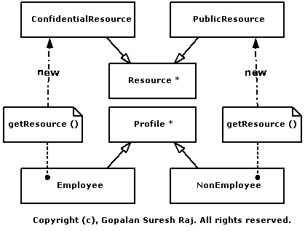

Slide 8
1. Resource - An abstract base class that defines a common interface to different types of Resources in an Organization. These resources may represent individual files, directory structures, user-defined entities (such as catalogs, purchase orders etc.) etc. The listings below, illustrate how the Resource class is implemented in Java
public abstract class Resource {
public abstract void printMessage ();
  }

Slide 9
2. ConfidentialResource - A specialization of the Resource interface which represents resources which are Company Confidential resources which may not be accessed by anyone except the Company Employees.The listings below, illustrate how the ConfidentialResource class is implemented in Java.
public class ConfidentialResource extends Resource {
public void printMessage () {
System.out.println ("This is a Company Confidential Resource...");
}
}

Slide 10
3. PublicResource - A specialization of the Resource interface which represents resources which are available to anyone.The listings below, illustrate how the PublicResource class is implemented in Java.
public class PublicResource extends Resource {
public void printMessage ()
{
System.out.println ("This is a Public Resource...");
}
}

Slide 11
4. Profile - An abstract base class that defines a common interface to hold information about users like their Name, EMail Address, etc. A getResource() method is used to retrieve a reference to Resources. Employees have access to ConfidentialResources whereas, Non-Employees have access to PublicResources. The listings below, illustrate how the Profile class is implemented in Java.

Slide 12
public abstract class Profile {
public Profile (String sName, String sEmail) {
m_sName = sName;
m_sEmail = sEmail;
}
public String getName () {
return m_sName;
}
public String getEmail () {
return m_sEmail;
}
public boolean IsEmployee () {
return m_bIsEmployee;
}
public abstract Resource getResource ();
protected String m_sName, m_sEmail;
protected boolean m_bIsEmployee;
}

Slide 13
5. Employee - A specialization of the Profile interface represents an Object associated with an Employee of the Company. The IsEmployee() method returning a boolean value is used to test to see if the Object represents an employee of the Company.
6. NonEmployee - A specialization of the Profile interface represents an Object associated with users who are Non-Employee of the Company. The IsEmployee() method returning a boolean value is used to test to see if the Object represents an employee of the Company.

